Slide 1
Foundation of Data Science
Unit-2

Slide 2
Python: Variables
Variables are nothing but reserved memory locations to store values.
Based on the data type of a variable, the interpreter allocates memory and decides what can be stored in the reserved memory. Therefore, by assigning different data types to variables, you can store integers, decimals or characters in these variables.
Assigning Values to Variables
Python variables do not need explicit declaration to reserve memory space. The declaration happens automatically when you assign a value to a variable. The equal sign (=) is used to assign values to variables.
The operand to the left of the = operator is the name of the variable and the operand to the right of the = operator is the value stored in the variable.

Slide 3
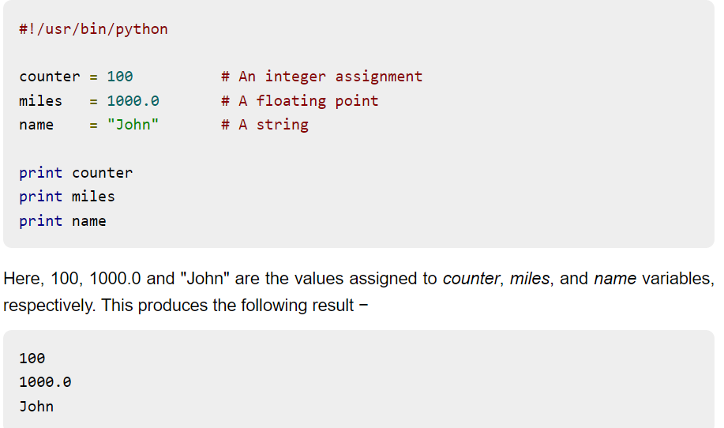
Python: Variables

Slide 4
Print and end argument
Using print statement
Salary = 7000
Print(“total salary is Salary”)
Print(“total salary is :”, Salary)
O/p
total salary is salary
Total salary is : 7000
Using End argument in print() function, will cause the cursor to remain on the same line for the next text.
Print(‘welcome’ , end=‘ ’)
Print (‘to’ , end =‘ ’)
Print(‘India’, end =‘ ’)
O/p
Welcome to India
Task: Explore the usage of “ Sep” Argument

Slide 5
Input in Python
Input()- it only accepts the string data
Ex. Num = input(“enter the number”)
Print(“the number is:”, num, “and the class is:”, type(num))
Int() – it accepts numeric I/P in the form of integer or float
Ex. Salary = int(input(“Enter the salary:”)
Print(“The salary is:”, Salary)
o/p The salary is : 15000
Float() –along with input() it accepts decimal values
Eval() – it considers the datatype according to the nature of the input provided.
Ex. Val1 = eval(input(“enter the value of first variable”)
Print(‘val1 =’, val1, ‘type:’, type(val1))

Slide 6
Basic Parent Libraries in Python
NumPy – Numerical Python
Pandas – Dataframe Python
Matplotlib – Visualization
Sklearn – Machine Learning

Slide 7
Datatypes in Python
Numbers – integer, floating point and complex number
Python doesn't have upper bound of integers like C or C++
Strings – can be enclosed in single or double quotes
Boolean – either of the two keywords True or False
List – like an array
Contains similar type or different types of elements
It is an ordered sequence, where each value can be fetched using index value
All the elements are enclosed in square brackets and separating each value using comma
Ex. Mylist1 = [“abc”, “def”, “xyz”, 20, 50.5 ]
Print(Mylist1)
Tuples
Dictionary

Slide 8
Datatypes in python - Lists
Operations on lists:
Concatenation using + operator
# Concatlist1 = mylist1+mylist2
Slicing – using : operator
# slicelist1 = mylist1[0:2]
it will take elements from index 0 to index 1, that is total 2
We can change the interval also, by adding 3rd value in the [] brackets
Repetition – using * operator
# replist1 = 3 * mylist1

Slide 9
Datatypes in Python- Tuples
Tuple – set of data items, similar to lists
Difference b/w lists and tuples are
Ex. Mylist = [“sun”, “moon”, 2,10.5]
Mytuple = (“sun”, “moon”, 2,10.5)
Mylist[1] = “stars”
Print(mylist)
o/p- [‘sun’, ‘stars’, 2,10.5]
In tuples, cannot change any element at any index
Ex. Tupsample = (1,2,3,4,’py’)
Lists | Tuples
Elements are enclosed in [] brackets | Elements are enclosed in ()
Lists are mutable- alterations can be done | Tuples are read only, immutable

Slide 10
Datatypes in Python- Dictionary
Dictionary- it is a collection of elements key-value pair
Each key is mapped to its associated value
Dictionary can be defined using a comma separated list of key value pair, enclosed in curly braces {}
To get the value corresponding to a key in the dictionary,
Dictionaryname.values()
Dictionaryname.keys()
Ex.
capitals = {"USA":"Washington D.C.", "France":"Paris", "India":"New Delhi"}
print(type(capitals))
#output: <class 'dict’>
Print(capitals[“France”]) #will print the value from the key France
Print(capitals.keys()) # will print all the keys in a dictionary
Print(capitals.values()) #will print all the values in a dictionary

Slide 11
Datatypes in Python- Dictionary
numNames={1:"One", 2: "Two", 3:"Three"}
# int key, string value
decNames={1.5:"One and Half", 2.5: "Two and Half", 3.5:"Three and Half"} # float key, string value
items={("Parker","Reynolds","Camlin"):"pen", ("LG","Whirlpool","Samsung"): "Refrigerator"}
# tuple key, string value
romanNums = {'I':1, 'II':2, 'III':3, 'IV':4, 'V':5}
# string key, int value

Slide 12
Datatypes in Python- Set
Set- allows you to create a random or an order less collection of data.
Lists and dictionaries are ordered collection in Python, where data has a sequence and index for each data.
However, Set is an unordered collection of data and it doesn't contain any duplicate elements or values.
It can be created by enclosing data items within the curly braces{}
Ex. flowers = {“rose”, “lily”, “marigold”}
Print(flowers)
Print(type(flowers)) #o/p- <class ‘set’>
Or it can be created using the function set()
Flowers = set([“rose”, “lily”, “marigold”])
Print(flowers)
Print(type(flowers)) #o/p- <class ‘set’>

Slide 13
Python Operators
Python language supports the following types of operators.
Arithmetic Operators
Comparison (Relational) Operators
Assignment Operators
Logical Operators
Membership Operators
Bitwise Operators

Slide 14
Operators and operands
Operators are special symbols that help in carrying out an assignment operation or arithmetic or logical computation
Value that the operator operates on is called operands
ex. In[1]: 2+3
out[1]: 5

Slide 15
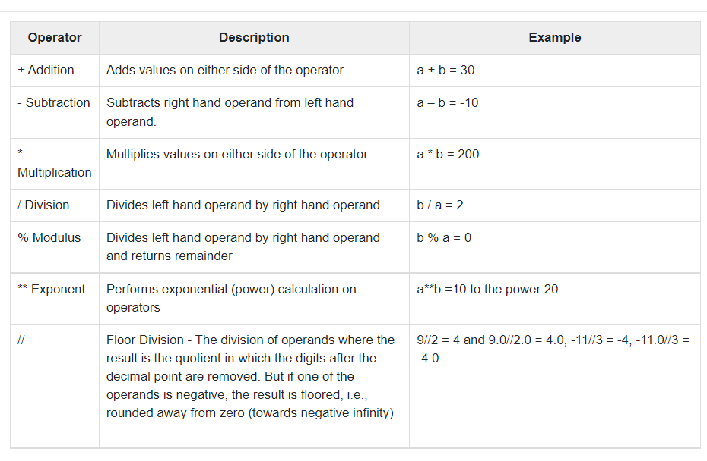
Python Operators: Arithmetic(+,-,*,/,%,**)

Slide 16
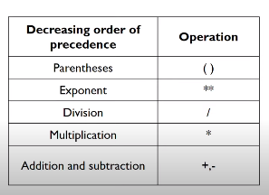
Hierarchy of Operators

Slide 17
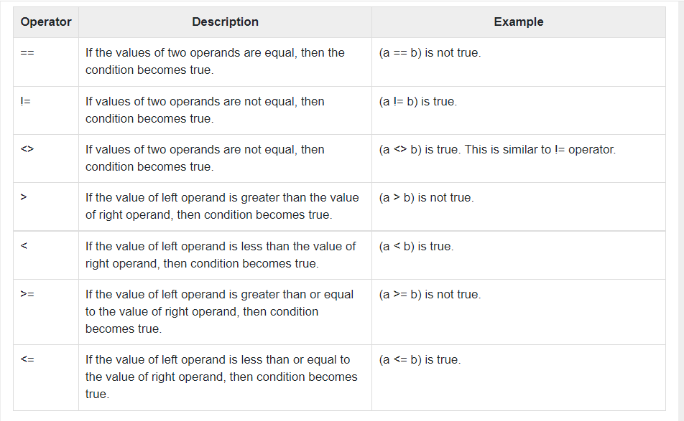
Python Operators: Relational or Comparison

Slide 18
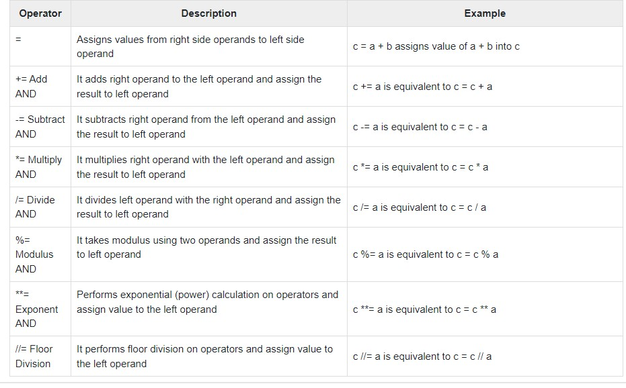
Python Operators: Assignment

Slide 19
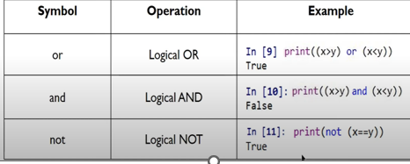
Python Operators: logical
Used when operands are conditional statements and returns Boolean value.
In Python, logical operators are designed to work with scalars or Boolean values

Slide 20
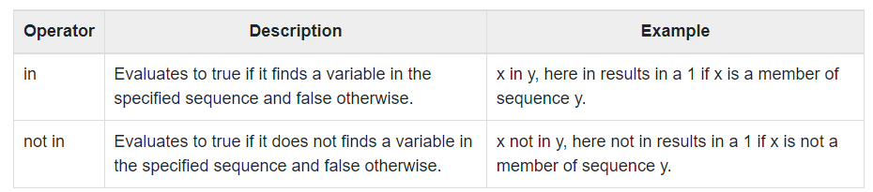
Python Operators: membership
Ex. X=5, y = [2,5,7,8,10]
X in y o/p- true
X not in y o/p- false

Slide 21
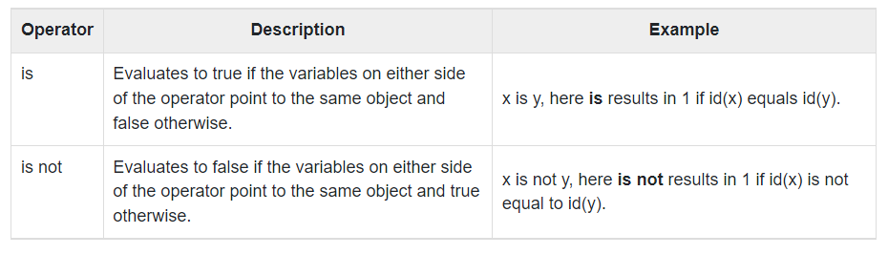
Python Operators: Identity
Identity operators compare the memory locations of two objects. There are two Identity operators explained below:

Slide 22
Python Operators: Bitwise
OPERATOR | NAME | DESCRIPTION | SYNTAX
& | Bitwise AND | Result bit 1,if both operand bits are 1;otherwise results bit 0. | x & y
| | Bitwise OR | Result bit 1,if any of the operand bit is 1; otherwise results bit 0. | x | y
~ | Bitwise NOT | inverts individual bits | ~x
^ | Bitwise XOR | Results bit 1,if any of the operand bit is 1 but not both, otherwise results bit 0. | x ^ y
>> | Bitwise right shift | The left operand’s value is moved toward right by the number of bits specified by the right operand. | x>>
<< | Bitwise left shift | The left operand’s value is moved toward left by the number of bits specified by the right operand. | x<<

Slide 23
Python Operators: Bitwise Shift
Right Shift : Shifts the bits of the number to the right and fills 0 on voids left( fills 1 in the case of a negative number) as a result.
Example 1:
a = 10 = 0000 1010 (Binary)
a >> 1 = 0000 0101 = 5
Example 2:
a = -10 = 1111 0110 (Binary)
a >> 1 = 1111 1011 = -5
left shift: Shifts the bits of the number to the left and fills 0 on voids right as a result.
Example 1:
a = 5 = 0000 0101 (Binary)
a << 1 = 0000 1010 = 10
a << 2 = 0001 0100 = 20
Example 2:
b = -10 = 1111 0110 (Binary)
b << 1 = 1110 1100 = -20
b << 2 = 1101 1000 = -40

Slide 24
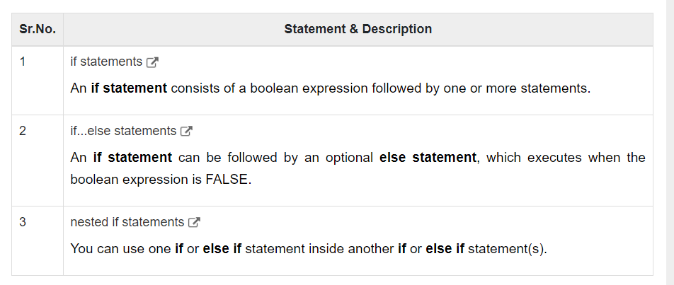
Python: If Statement

Slide 25
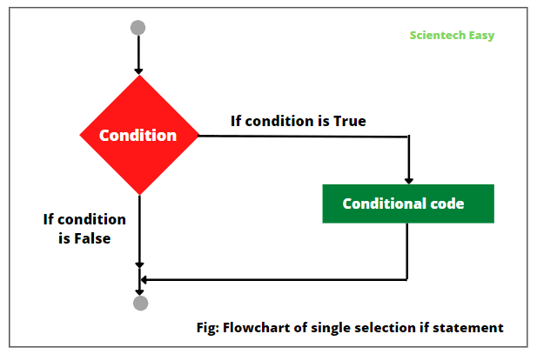
If Statement

Slide 26
If Statement
When <condition> is evaluated by Python, it’ll become either True or False (Booleans). Thus, if the condition is True (i.e, it is met), the <expression> will be executed, but if <condition> is False (i.e., it is not met), the <expression> won’t be executed.
# Basic if statement
x = 3
y = 10
if x < y:
print("x is smaller than y.")

Slide 27
else statement
What if we want to execute some code if the condition isn't met? We add an else statement below the if statement. Let’s look at an example
# else statement
x = 3
y = 10
if x > y:
print("x is greater than y.")
else:
print("x is smaller than y.").

Slide 28
The elif Statement
The elif statement allows you to check multiple expressions for TRUE and execute a block of code as soon as one of the conditions evaluates to TRUE.
Similar to the else, the elif statement is optional. However, unlike else, for which there can be at most one statement, there can be an arbitrary number of elif statements following an if.
if expression1:
statement(s)
elif expression2:
statement(s)
elif expression3:
statement(s)
else:
statement(s)

Slide 29
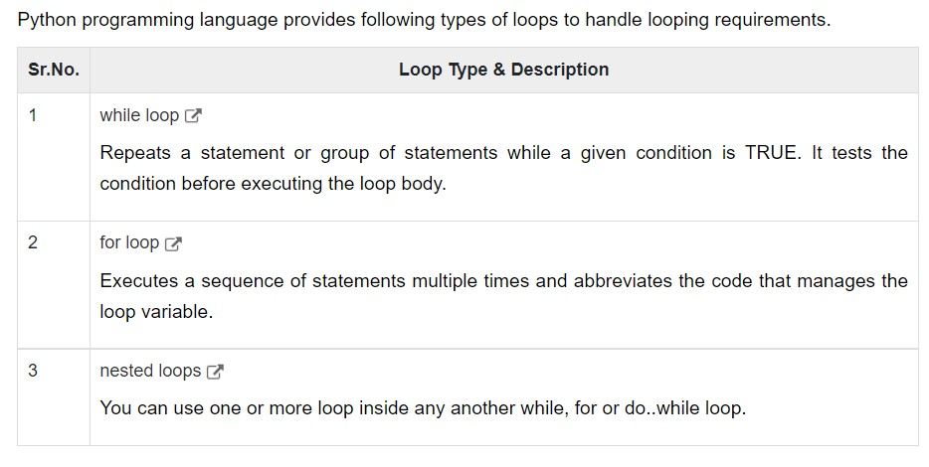
Python: Loops

Slide 30
Exploratory Data Analysis
Exploratory data analysis (EDA) is used by data scientists to analyze and investigate data sets and summarize their main characteristics, often employing data visualization methods.
It helps determine how best to manipulate data sources to get the answers you need, making it easier for data scientists to discover patterns, spot anomalies, test a hypothesis, or check assumptions.

Slide 31
EDA Methods and Techniques
Data Visualization
Correlation Analysis
Dimensionality Reduction
Descriptive Statistics
Clustering
Outlier Detection

Slide 32
Types of exploratory data analysis
There are four primary types of EDA:
Univariate non-graphical. This is simplest form of data analysis, where the data being analyzed consists of just one variable. Since it’s a single variable, it doesn’t deal with causes or relationships. The main purpose of univariate analysis is to describe the data and find patterns that exist within it.
Univariate graphical. Non-graphical methods don’t provide a full picture of the data. Graphical methods are therefore required. Common types of univariate graphics include:
Stem-and-leaf plots, which show all data values and the shape of the distribution.
Histograms, a bar plot in which each bar represents the frequency (count) or proportion (count/total count) of cases for a range of values.
Box plots, which graphically depict the five-number summary of minimum, first quartile, median, third quartile, and maximum.
Multivariate nongraphical: Multivariate data arises from more than one variable. Multivariate non-graphical EDA techniques generally show the relationship between two or more variables of the data through cross-tabulation or statistics.
Multivariate graphical: Multivariate data uses graphics to display relationships between two or more sets of data. The most used graphic is a grouped bar plot or bar chart with each group representing one level of one of the variables and each bar within a group representing the levels of the other variable.

Slide 33
Steps in EDA
Problem Definition/understanding the data
Data Preparation/ Cleaning the data
Data Analysis
Development and representation of the results

Slide 34
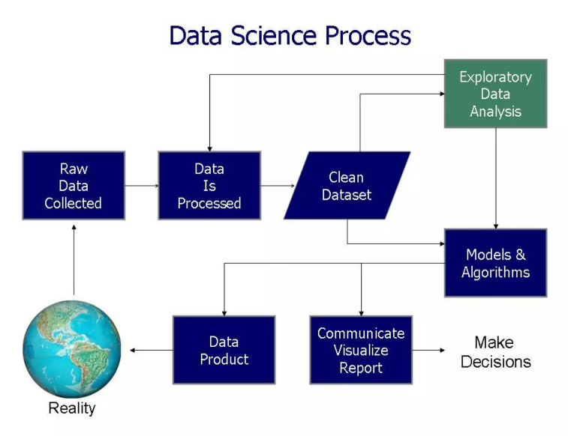

Slide 35
Categories of Data
Structured - csv files, excel files, database files
Unstructured - images, videos, audios

Slide 36
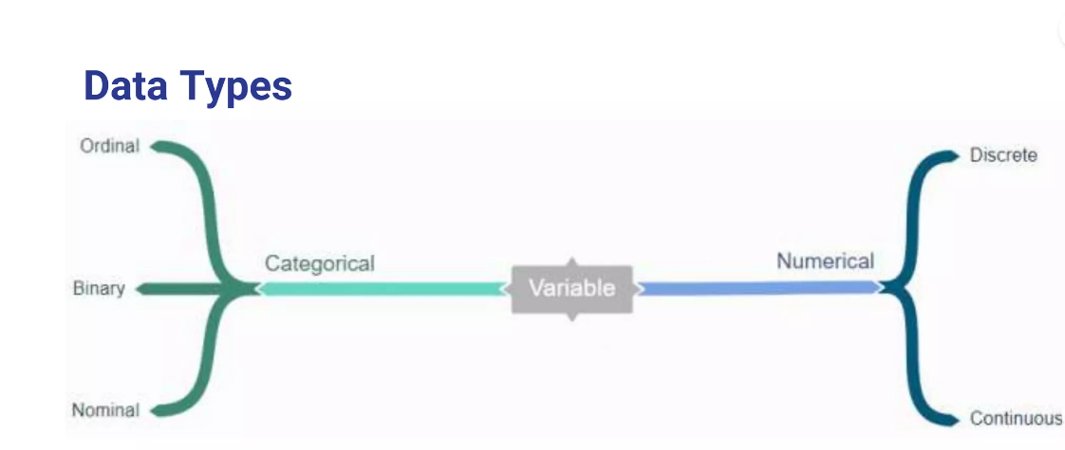
Data Types

Slide 37
Structured Data Type
Categorical – This is any data which is not a number
Ordinal- have a set of order eg. Rating happiness on a scale of 1-10
Binary – have only two values eg. Male or Female
Nominal – no set of order eg. Countries
Numerical- Data in form of numbers
Continuous – numbers that don’t have a logical end to them eg. Heights
Discrete – have a logical end to them eg. Days in a month

Slide 38

Python Packages for EDA

Slide 39
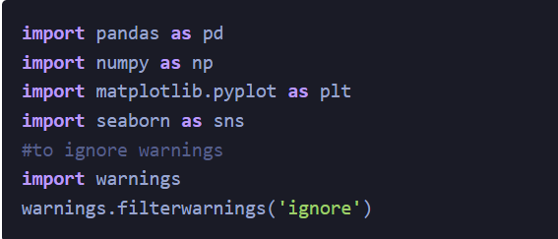
Importing Libraries- Step 1

Slide 40
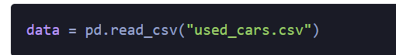
Reading/Importing Dataset- Step 2
The Pandas library offers a wide range of possibilities for loading data into the pandas DataFrame from files like JSON, .csv, .xlsx, .sql, .pickle, .html, .txt, images etc.
Most of the data are available in a tabular format of CSV files. It is trendy and easy to access. Using the read_csv() function, data can be converted to a pandas DataFrame.
the data to predict Used car price is being used as an example. In this dataset, we are trying to analyze the used car’s price and how EDA focuses on identifying the factors influencing the car price.

Slide 42
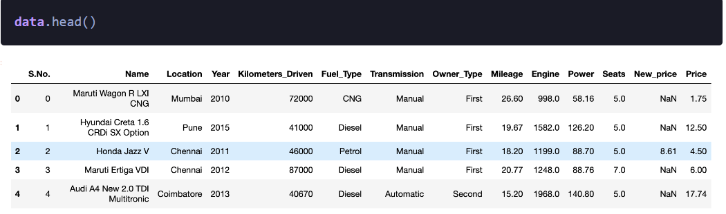
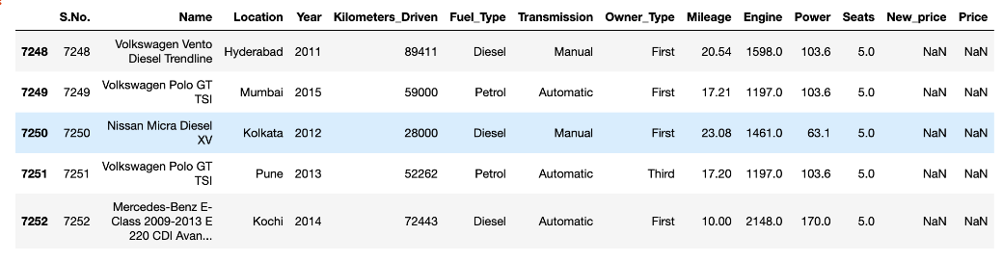
Analyse the dataset
Head will show first 5 records present in the dataset
Tail will show last 5 records present in the dataset

Slide 43
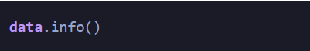
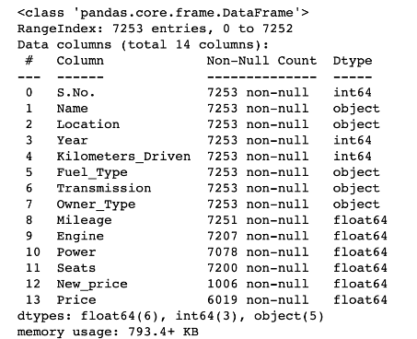
Analyse the dataset
info() helps to understand the data type and information about data, including the number of records in each column, data having null or not null, Data type, the memory usage of the dataset
data.info() shows the variables Mileage, Engine, Power, Seats, New_Price, and Price have missing values. Numeric variables like Mileage, Power are of datatype as float64 and int64. Categorical variables like Location, Fuel_Type, Transmission, and Owner Type are of object data type

Slide 44
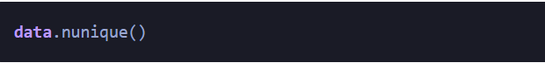
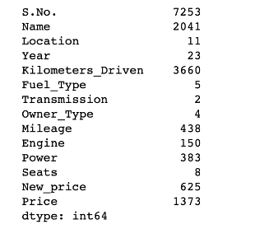
Analyse the dataset
Check for Duplication
nunique() based on several unique values in each column and the data description, we can identify the continuous and categorical columns in the data. Duplicated data can be handled or removed based on further analysis

Slide 45
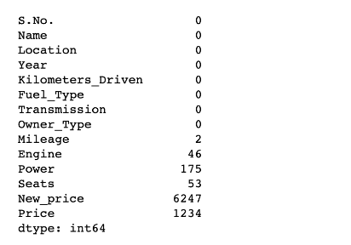
Analyse the dataset
Missing Values Calculation
isnull() is widely been in all pre-processing steps to identify null values in the data
In our example, data.isnull().sum()
is used to get the number of missing records in each column

Slide 46
Analyse the dataset
Handling Missing Values
Junk values can be converted to missing values by passing them as a list to the parameter ‘na_values’
data = pd.read_csv(“usedcars.csv”, na_values =[“??”, “###”]

Slide 47
Missing Values in Python
Let us consider an online survey for a product.
Many a times, people do not share all the information related to them.
Few people share their experience, but not how long they are using the product; few people share how long they are using the product, their experience but not their contact information.
Thus, in some or the other way a part of data is always missing, and this is very common in real time.

Slide 48
Dropping Missing Values
If you want to simply exclude the missing values, then use the dropna function along with the axis argument.
By default, axis=0, i.e., along row, which means that if any value within a row is NA then the whole row is excluded.

Slide 49
Replace Missing or Generic Values
Many times, we have to replace a generic value with some specific value. We can achieve this by applying the replace method.
Replacing NA with a scalar value is equivalent behavior of the fillna() function.

Slide 50
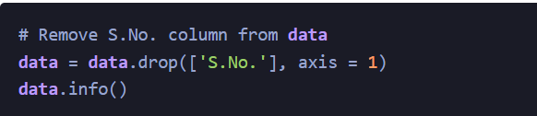
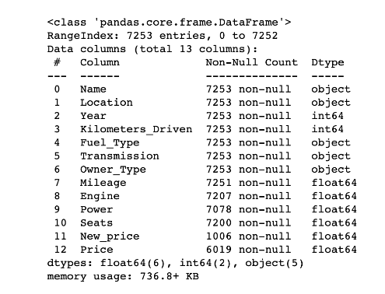
Data Reduction – Step 3
Some columns or variables can be dropped if they do not add value to our analysis.
In our dataset, the column S.No have only ID values, assuming they don’t have any predictive power to predict the dependent variable.

Slide 51
Feature Engineering- Step 4
Feature engineering refers to the process of using domain knowledge to select and transform the most relevant variables from raw data when creating a predictive model using machine learning or statistical modeling.
The main goal of Feature engineering is to create meaningful data from raw data.

Slide 52
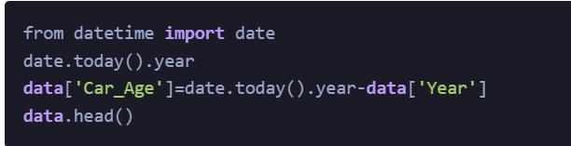
Creating Features – Step 5
If we see the sample data, the column “Year” shows the manufacturing year of the car.
It would be difficult to find the car’s age if it is in year format as the Age of the car is a contributing factor to Car Price.
Introducing a new column, “Car_Age” to know the age of the car

Slide 53
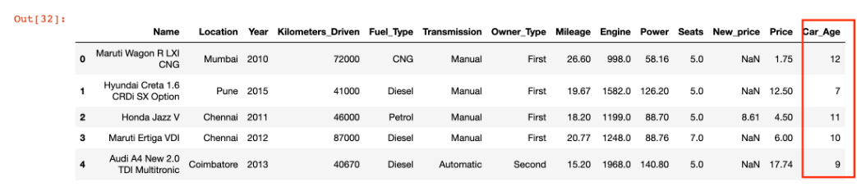

Slide 54
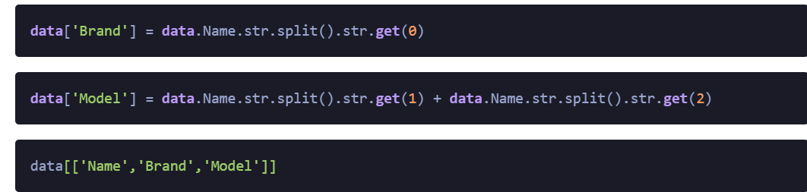
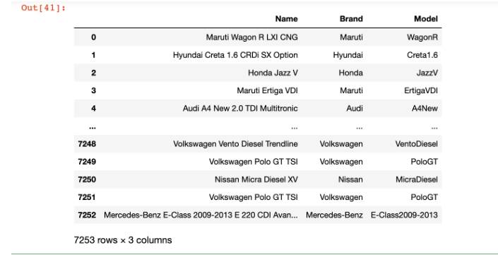
Since car names will not be great predictors of the price in our current data. But we can process this column to extract important information using brand and Model names. Let’s split the name and introduce new variables “Brand” and “Model”

Slide 55
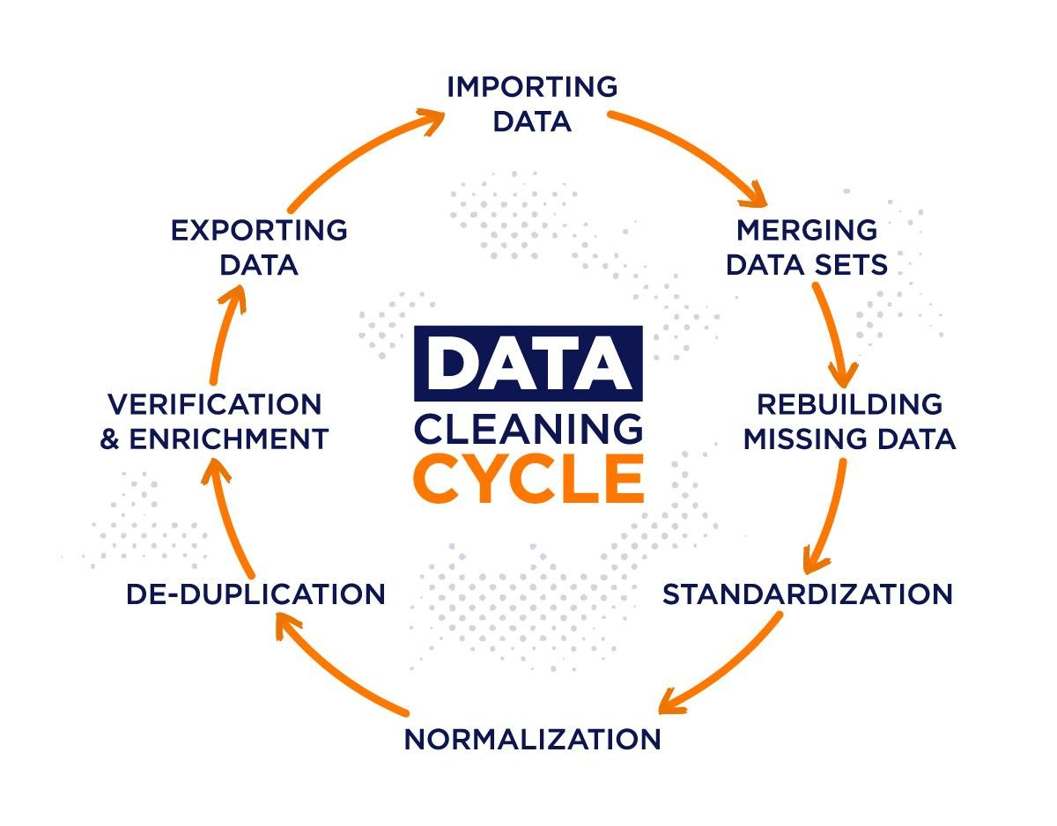
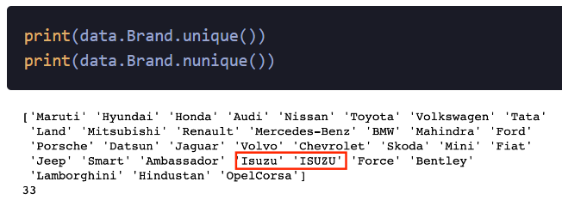
Data Cleaning- Step 6
Some names of the variables are not relevant and not easy to understand. Some data may have data entry errors, and some variables may need data type conversion. We need to fix this issue in the data.
In the example, The brand name ‘Isuzu’ ‘ISUZU’ and ‘Mini’ and ‘Land’ looks incorrect. This needs to be corrected

Slide 56
EDA Exploratory Data Analysis – Step 7
Exploratory Data Analysis refers to the crucial process of performing initial investigations on data to discover patterns to check assumptions with the help of summary statistics and graphical representations.
EDA can be leveraged to check for outliers, patterns, and trends in the given data.
EDA helps to find meaningful patterns in data.
EDA provides in-depth insights into the data sets to solve our business problems.
EDA gives a clue to impute missing values in the dataset

Slide 57
Statistics Summary – Step 8
The information gives a quick and simple description of the data.
Can include Count, Mean, Standard Deviation, median, mode, minimum value, maximum value, range, standard deviation, etc.
Statistics summary gives a high-level idea to identify whether the data has any outliers, data entry error, distribution of data such as the data is normally distributed or left/right skewed
In python, this can be achieved using describe()
describe() function gives all statistics summary of data
describe()– Provide a statistics summary of data belonging to numerical datatype such as int, float

Slide 58
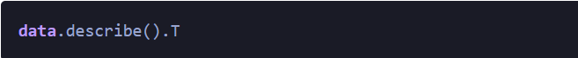
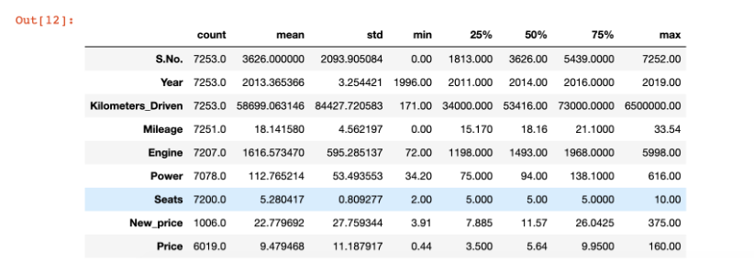

Slide 59
Data visualization
Data visualization is a field in data analysis that deals with visual representation of data. It graphically plots data and is an effective way to communicate inferences from data.
Using data visualization, we can get a visual summary of our data. With pictures, maps and graphs, the human mind has an easier time processing and understanding any given data.
Python offers several plotting libraries, namely Matplotlib, Seaborn

Slide 60
Matplotlib | Seaborn
It is used for basic graph plotting like line charts, bar graphs, etc. | It is mainly used for statistics visualization and can perform complex visualizations with fewer commands.
It mainly works with datasets and arrays. | It works with entire datasets.
Seaborn is considerably more organized and functional than Matplotlib and treats the entire dataset as a solitary unit. | Matplotlib acts productively with data arrays and frames. It regards the aces and figures as objects.
Seaborn has more inbuilt themes and is mainly used for statistical analysis. | Matplotlib is more customizable and pairs well with Pandas and Numpy for Exploratory Data Analysis.

Slide 61
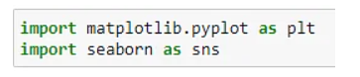
Line Charts
A Line chart is a graph that represents information as a series of data points connected by a straight line.
In line charts, each data point or marker is plotted and connected with a line or curve.
Let's consider the apple yield (tons per hectare) Let's plot a line graph using this data and see how the yield of apples changes over time. We start by importing Matplotlib and Seaborn.

Slide 62
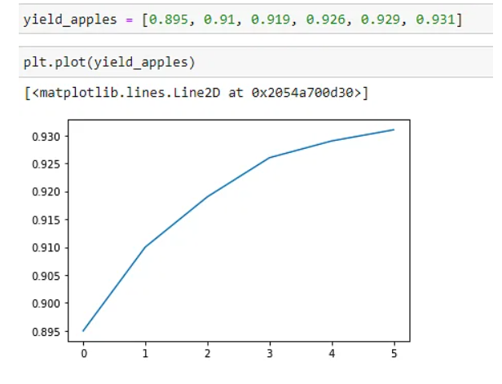

Slide 63
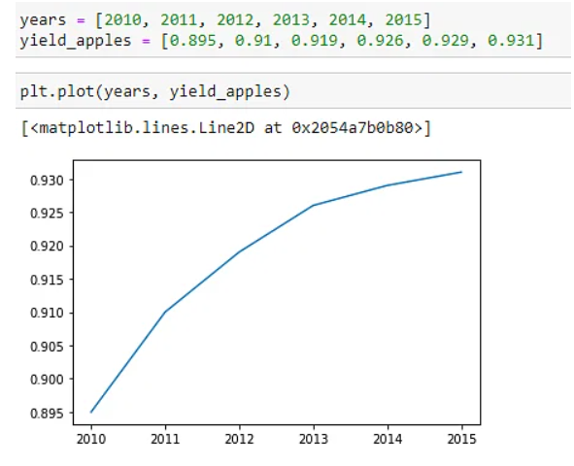
To better understand the graph and its purpose, we can add the x-axis values too.

Slide 64
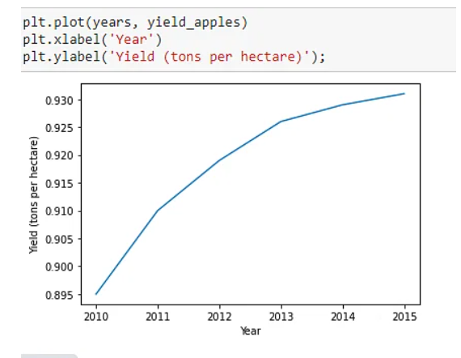
Let's add labels to the axes so that we can show what each axis represents.

Slide 65
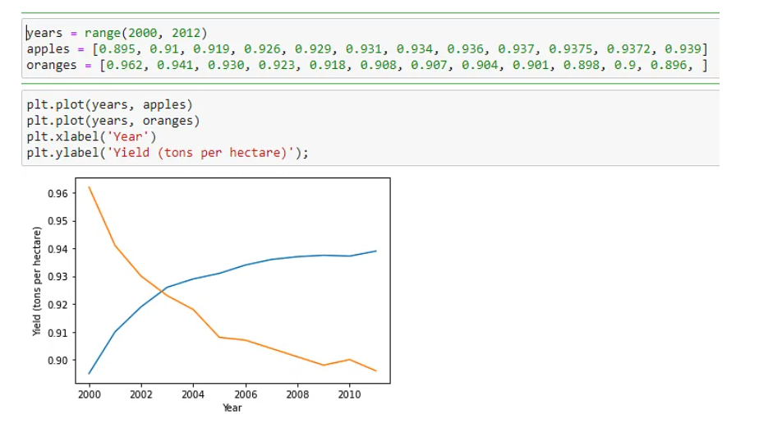
To plot multiple datasets on the same graph, just use the plt.plot function once for each dataset. Let's use this to compare the yields of apples vs. oranges on the same graph.

Slide 66
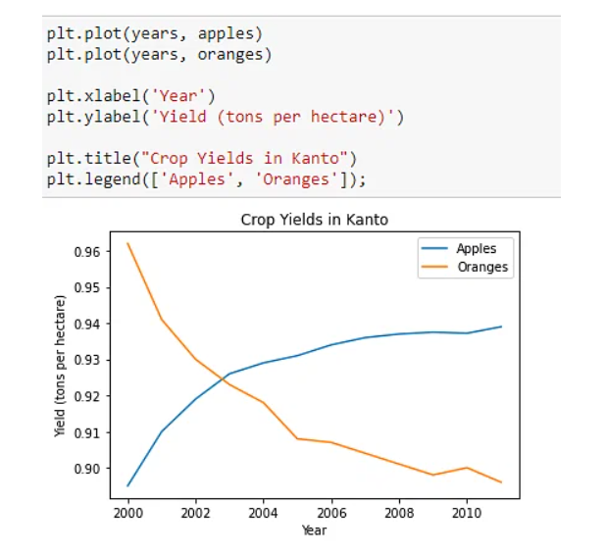
We can add a legend which tells us what each line in our graph means. To understand what we are plotting, we can add a title to our graph.

Slide 67
Bar Graphs
When you have categorical data, you can represent it with a bar graph. A bar graph plots data with the help of bars, which represent value on the y-axis and category on the x-axis. Bar graphs use bars with varying heights to show the data which belongs to a specific category.

Slide 68
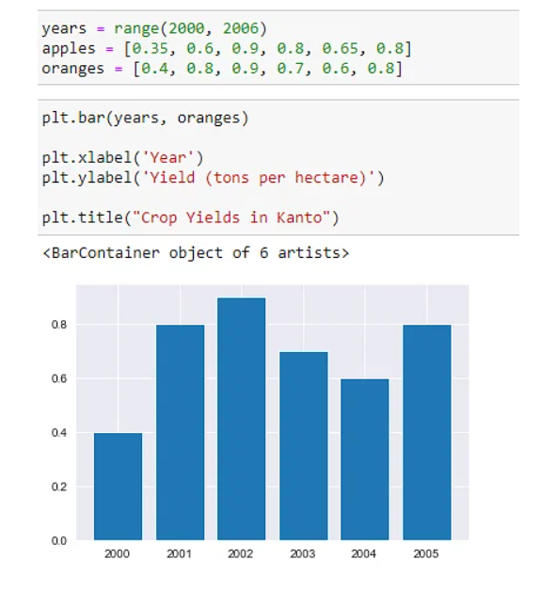

Slide 69
Histogram
A Histogram is a bar representation of data that varies over a range.
It plots the height of the data belonging to a range along the y-axis and the range along the x-axis.
Histograms are used to plot data over a range of values.
They use a bar representation to show the data belonging to each range.
Let's again use the ‘Iris’ data which contains information about flowers to plot histograms.

Slide 70
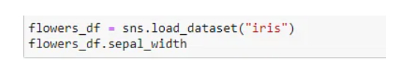
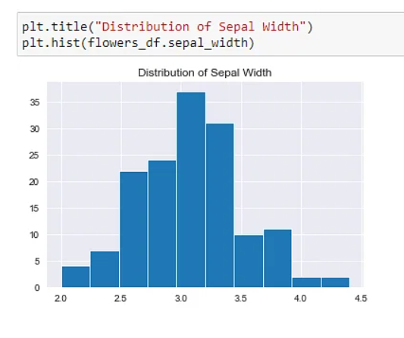

Slide 71
Scatter Plot
Scatter plots are used when we have to plot two or more variables present at different coordinates.
The data is scattered all over the graph and is not confined to a range. Two or more variables are plotted in a Scatter Plot, with each variable being represented by a different color.
Let's use the ‘Iris’ dataset to plot a Scatter Plot.

Slide 72
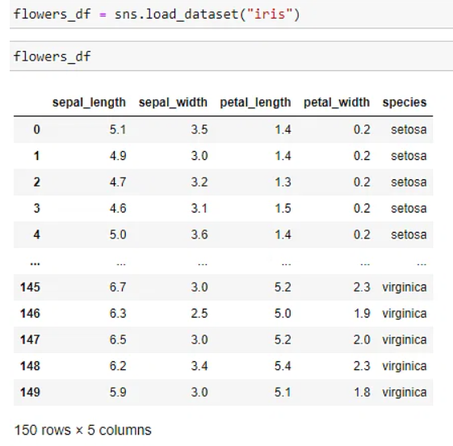
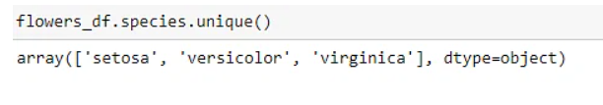
First, let’s see how many different species of flowers we have.

Slide 73
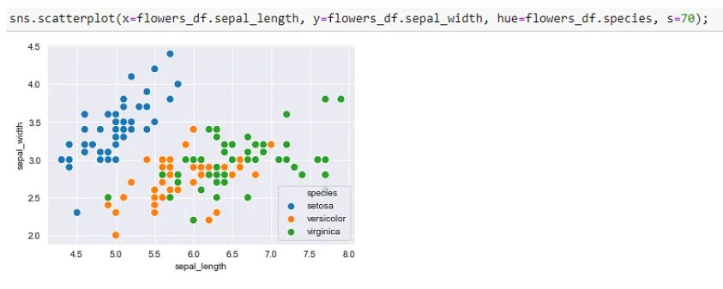

Slide 74
Heatmaps
Heatmaps are used to see changes in behavior or gradual changes in data.
It uses different colors to represent different values. Based on how these colors range in hues, intensity, etc., tells us how the phenomenon varies.
Let's use heatmaps to visualize monthly passenger footfall at an airport over 12 years from the flights dataset in Seaborn.

Slide 75
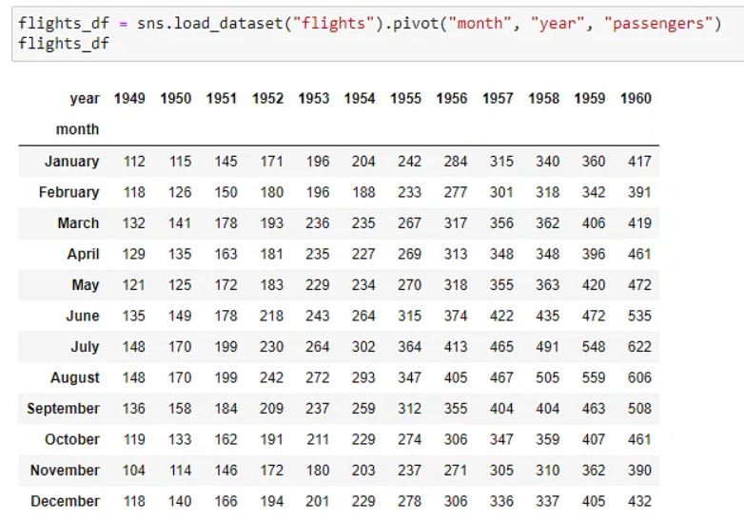
The above dataset, flights_df shows us the monthly footfall in an airport for each year, from 1949 to 1960. The values represent the number of passengers (in thousands) that passed through the airport

Slide 76
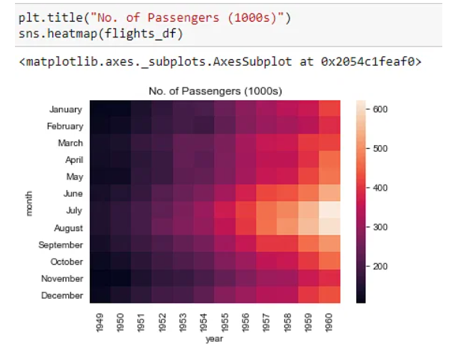
The brighter the color, the higher the footfall at the airport. By looking at the graph, we can infer that :
The annual footfall for any given year is highest around July and August.
The footfall grows annually. Any month in a year will have a higher footfall when compared to the previous years.

Slide 77
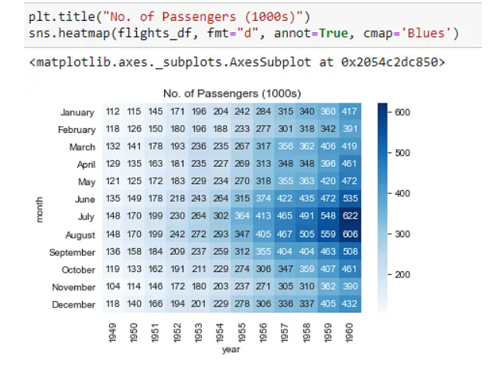
Let's display the actual values in our heatmap and change the hue to blue.

Slide 78
Synthetic Data Vault (SDV): A Python Library for Dataset Modelling
In data science, you usually need a realistic dataset to test your proof of concept.
Creating fake data that captures the behavior of the actual data may sometimes be a rather tricky task.
Several python packages try to achieve this task.
Few popular python packages are Faker, Mimesis.
However, there are mostly generating simple data like generating names, addresses, emails, etc.

Slide 79
pip install Faker
To use the Faker package to generate synthetic data, we need to initiate the Faker class.
from faker import Faker fake = Faker()
fake.name()
The result is a person’s name when we use the .name attribute from the Faker class. Faker synthetic data would produce randomly each time we run the attribute. Let’s run the name one more time. The result is a different name than our previous iteration. The randomization process is important in generating synthetic data because we want a variation in our dataset.
There are many more variables we could generate using the Faker package. It is not limited to the name variable — the other example are address, bank, job, credit score, and many more. In the Faker package, this generator is called Provider.

Slide 80
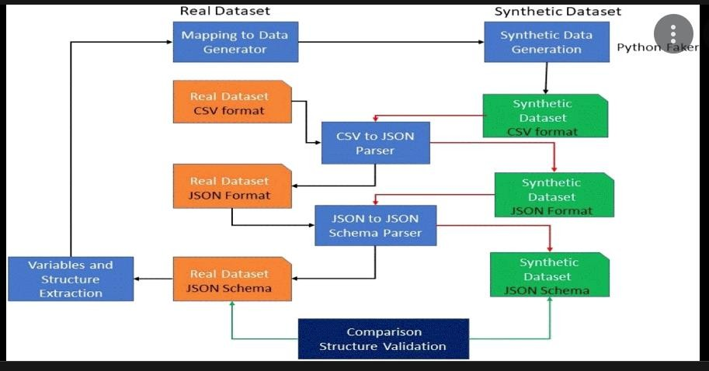
Synthetic Dataset Generation

